Slide 1
MCTV Limited
22nd April
2017
Presented by: Grigor Danut, Antonio Penna, Jack Gallaher and Dylan Gilroy.

Slide 2
Agenda
Jack
The purpose of this presentation was to explore the development of MCTV Limited.
We as a group were given particular tasks in which we all had to take part in.
This presentation will feature a quick background MCTV Limited, the UML charts, Databases, the company Website and what holds for the future of MCTV Limited as the company grows.

Slide 3
Introduction to Company
Jack
With the headquarter in Dublin, company has been manufacturing TV since 1955
MCTV use only the highest quality components
Supporting the local job market and grow local industries

Slide 4
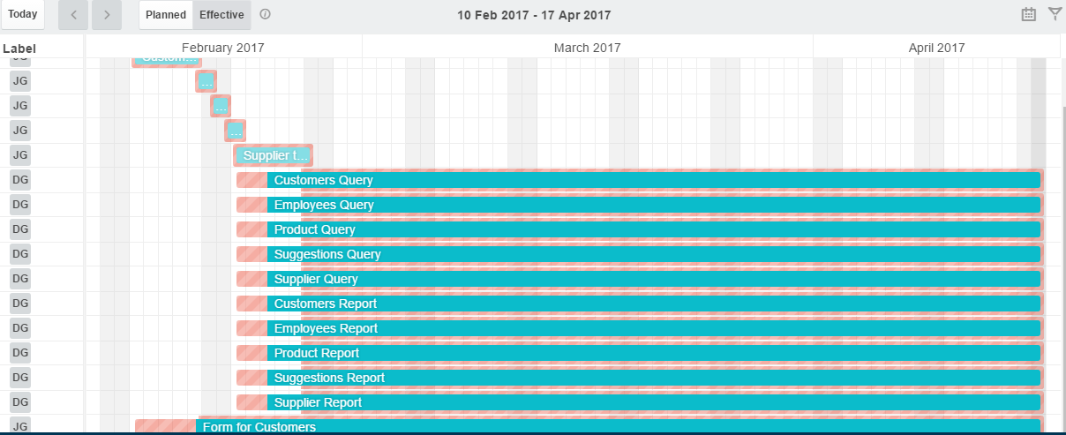
Gantt Chart
Dylan
The Gannt charts shows the progression the group has made over the last few months and all the times it was updated
Microsoft Databases

Slide 5
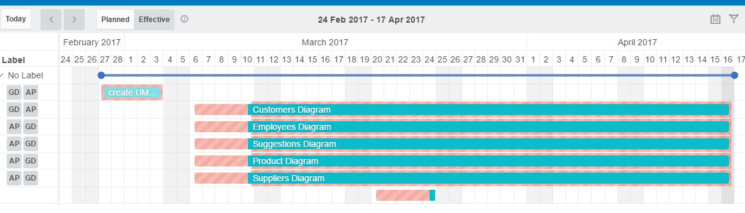
Gantt Chart
UML Charts

Slide 6
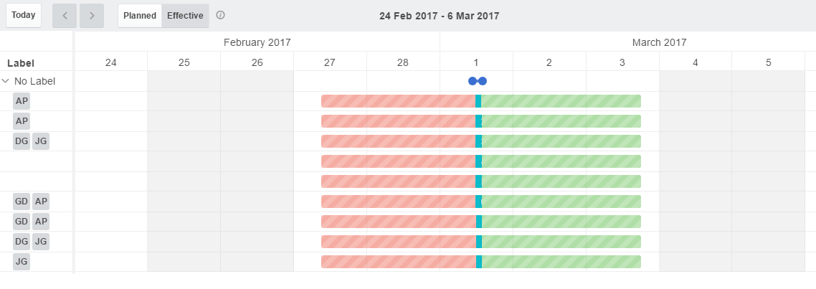
Gantt Chart
Presentation

Slide 7
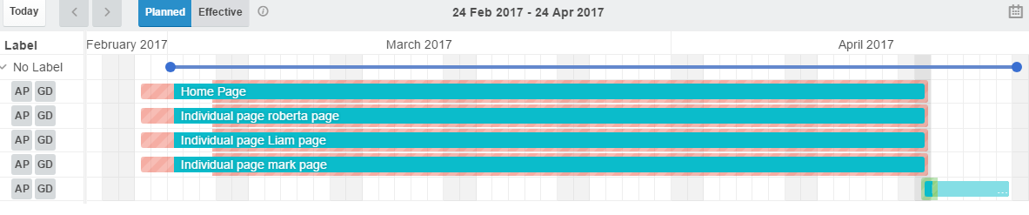
Gantt Chart
Word Press

Slide 8
Individual Task
Dylan
Databases – Dylan Gilroy and Jack Gallaher
UML charts – Antonio Penna and Grigor Danut
WordPress – Antonio Penna and Grigor Danut
Trello – Jack Gallaher
Presentation slides– Antonio Penna–layout, front page, introduction
Jack Gallaher-Agenda, Gantt chart, Conclusion, Last slide,
Grigor Daunt-UML charts, Website
Dylan Gilroy-Databases, individual Tasks

Slide 9
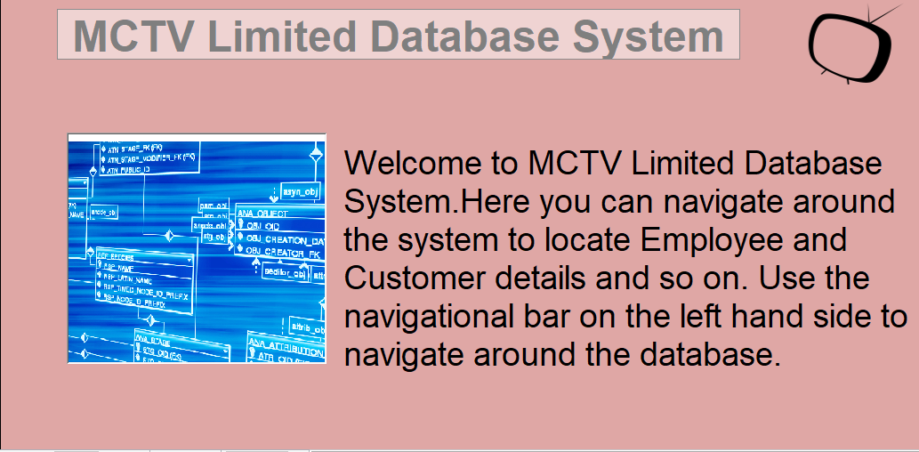
MCTV Limited

Slide 10
Databases
Grigor
Here we will show MCTV Limited Databases

Slide 11
UML chart
Grigor
Customers Table
Employees Table
Products Table
Suggestions Table
Suppliers Table
Navigation Form

Slide 12
UML Chart

Slide 13
Website
Antonio
Here we will present to you the MCTV Limited Website
Which will feature a Home page and 4 individual pages about the workers in the shop

Slide 14
Conclusion
Antonio
MCTV Limited will continue to grow as a company in future
We hope that as the company moves to the cloud it will become more efficient.
As cloud technology improves further into the future we hope that MCTV limited will follow and become a larger and better company.

Slide 15

Questions?
Everyone
Thank you for listening
Any Questions?

